Slide 1

Web Application Testing Darwin.md
Final project

Slide 2

APP DESCRIPTION
Darwin.md
Web application
Darwin.md is a convenient and reliable e-shop website that allows customers to purchase technical products.
National Shipping and possibility to pick up the products.

Slide 3
TESTING APPROACH
Exploratory testing- to discovery the site and find bugs.
Document the Exploratory Testing and write down defects so they can be replicated.
Smoke Testing for main functionalities.
Write the Smoke tests and execute them.
Write the Test Report .

Slide 4
TOOLS USED
Mantis Bug Tracker – Bug Reporting
Snipping Tool – Screenshots Capture
Xmind Tool – Mind Maps
Chat GPT – Terminology

Slide 5

TESTING TYPES
Exploratory Testing
Positive Testing
Smoke Testing
UI Testing
Usability Testing
Compatibility Testing
Performance Testing
PERFORMED
APPLICABLE

Slide 6
BUGS OVERVIEW

Slide 7
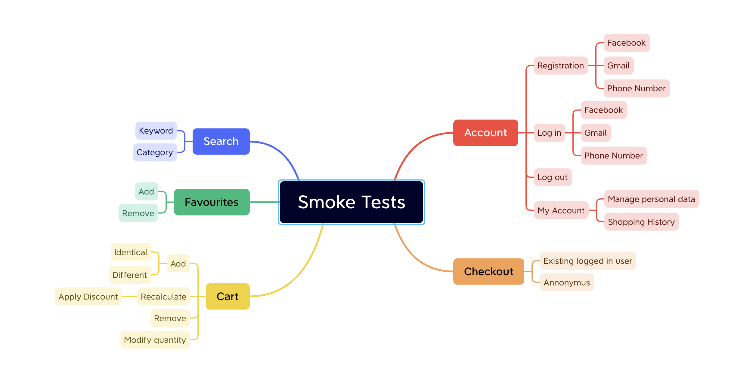
TEST CASE OVERVIEW

Slide 8

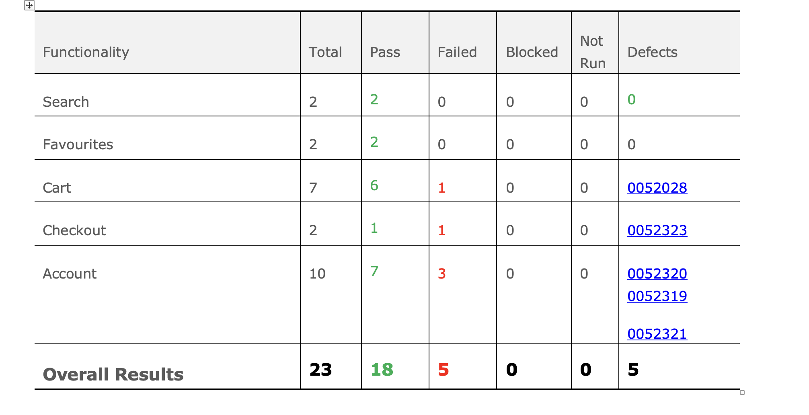
TEST CASE RESULTS

Slide 9
CONCLUSIONS
23 Test Cases were executed to test the happy flows : 18 passed and 5 failed
11 bugs identified : 1 critical, 3 major, 2 normal and 5 minor
Most of the bugs were identified by performing Exploratory Testing
Data type used during testing : Valid
Fixing at least the critical and major severity bugs is recomended

Slide 10
LESSONS LEARNED
On differnt browsers app might work differently
Vocabularay is very important when we write tase cases
Chat GPT can help with writing clare and simple test cases
The more test cases you write the easier it becomes

Slide 11

THANK YOU

